Slide 1
Data Preprocessing & EDA
Week 3 - Day 1

Slide 2

Why Data Preprocessing Matters
Turning Raw Data into Machine-Ready Fuel.
“Garbage in, garbage out - no model can overcome poor data quality."
Roadmap: The role of preprocessing in ML pipelines. Common challenges in raw datasets. Case study preview: Titanic survival prediction.

Slide 3




What You’ll Learn
Preprocessing
Why preprocessing is critical for ML success?
How do raw data challenges derail models?
By the end of this section, you’ll see preprocessing not as a chore, but as a strategic step to unlock your model’s potential."

Slide 4

The High Cost of Dirty Data
Real-World Failures
Key Insight
Healthcare: Missing patient age results in biased treatment recommendations.
Algorithms amplify data flaws.
Bad data kills - not just models, but trust.
Finance: Unscaled income vs. credit score results in skewed loan approvals.

Slide 5

What’s Wrong With This Picture?
1
Missing Values
2
Categorical Variables
3
Scale Mismatches
Gaps that distort statistics and break models.
Non-numeric data that algorithms can’t process.
Features with wildly different ranges.

Slide 6

Your Challenge: Prepare the Titanic Dataset
Problem Statement
Build a logistic regression model to predict survival.
Obstacles
How to handle missing ages?
How to convert "Sex" to numbers?
How to prevent "Fare" from dominating the model?

Slide 7
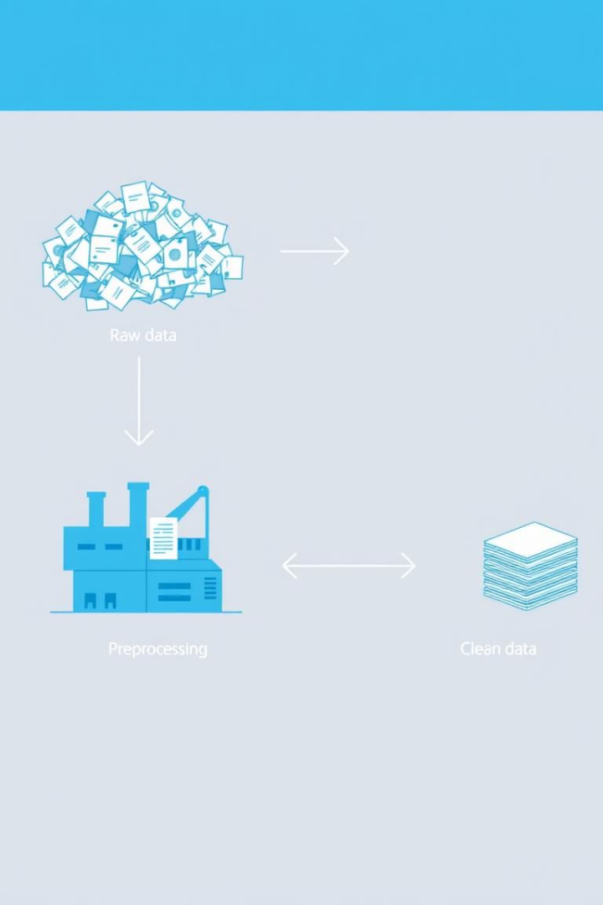



Key Takeaways (So Far)
Raw Data
Preprocessing
Missing Values, Scaling, Encoding
Clean Data
Three major hurdles: missing data, categorical variables, scale mismatches.

Slide 8

Next steps
Hands-on strategies
Imputing missing ages
In the next section, we’ll turn these principles into action: imputing missing ages, scaling fares, and encoding genders.
Scaling fares
Preprocessing isn’t just about fixing errors—it’s about curating a story your model can understand."

Slide 9
Handling Missing Values

Slide 10

Handling Missing Values: Strategies for Clean Data
Missing data presents a detour, not a dead end. Carefully navigate through detection, strategies, and real-world examples to turn gaps into insights. Master imputation, deletion, and flagging techniques to ensure robust and reliable data analysis.

Slide 11

What You’ll Learn
1
Detect
Employ visual and statistical tools to identify missing values within datasets.
2
Choose
Select the most appropriate strategy among imputation, deletion, or flagging.
3
Apply
Implement chosen strategies on real-world datasets such as the Titanic's 'Age' column.

Slide 12



The Domino Effect of Missing Data
Bias
Poor Predictions
Lost Trust
Missing data can lead to biased results and flawed predictions. In healthcare, missing cholesterol levels can lead to flawed risk assessments. In finance, blank income fields can lead to inaccurate credit scoring.

Slide 13
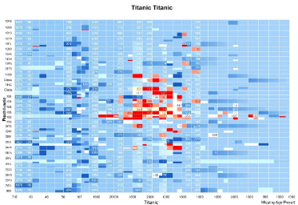
Finding the Gaps: Tools for Detection
Summary Stats
Visualization
Pattern Analysis
Use heatmaps (seaborn) or bar charts to visualize % missing per column.
Differentiate between MCAR (Missing Completely at Random) vs. MAR (Missing at Random).
df.isnull().sum()
Example: Titanic dataset has 177 missing "Age" values.

Slide 14



When to Delete: The Nuclear Option
1
Loss of Information
2
Biased Results
3
Missingness not MCAR
Deletion is appropriate when missingness is less than 5% (rows) or for redundant columns. Risks include information loss and biased results. Deleting 177 rows with missing "Age" removes ~20% of data.

Slide 15
Filling the Blanks: Art vs. Science
Mean/Median
Impute using median "Age" (28 years) for Titanic dataset.
Mode
Use mode for categorical data, such as "Embarked" → "S".
Advanced
Utilize KNN (K-Nearest Neighbors) to use neighbor features.
from sklearn.impute import SimpleImputer
imputer = SimpleImputer(strategy='median')
df['Age'] = imputer.fit_transform(df[['Age']])

Slide 16

Signal Missingness: Let the Model Know
1
Add Binary Column
Create a binary column like "Age_Missing".
2
Use Case
Ideal when missingness is informative.
3
Example
Add "Age_Missing" column: 1 if NaN, 0 otherwise.

Slide 17
Titanic Age Imputation: A Step-by-Step Guide
1
Analyze Missingness
2
Impute Strategically
3
Validate
Analyze missingness pattern. Impute using median "Age" grouped by "Pclass". Validate distributions pre/post imputation. Group-wise imputation respects socio-economic patterns.
df['Age'] = df.groupby('Pclass')['Age'].transform(lambda x: x.fillna(x.median()))

Slide 18



Avoiding Common Mistakes
Deleting Rows
Overusing Mean
Visualizing
2
1
3
Avoid overusing mean imputation on skewed data and deleting rows without analyzing patterns. Visualize distributions before/after imputation. Use domain knowledge like "Age" vs. "Pclass". What if missing 'Income' data correlates with high earners?

Slide 19

Key Takeaways
Strategy
Use Case
Tool
Deletion
Minimal missingness
dropna()
Imputation
Predictive relevance
SimpleImputer
Flagging
Informative missingness
Custom binary column
Missing data is inevitable. Choose your strategy wisely. Next up: Feature scaling and encoding for standardized data.

Slide 20
Feature Scaling & Normalization

Slide 21
Leveling the Playing Field
Why algorithms demand consistency in feature scales
Why scaling matters.
Standardization vs. normalization: Key differences.
Case study: Scaling "Fare" and "Age" in the Titanic dataset.

Slide 22

What You’ll Learn
1
Why?
2
How?
Algorithms like SVM, KNN, and gradient descent require scaled features.
Choose between standardization (Z-score) and normalization (Min-Max).
3
Apply?
Scaling techniques to the Titanic dataset using scikit-learn.

Slide 23
The Hidden Bias of Unscaled Features
Algorithm Sensitivity
Real-World Example
Distance-based models misprioritize high-magnitude features.
Loan approval models favoring "Income" over "Credit Score".
Gradient descent converges faster with scaled features.

Slide 24

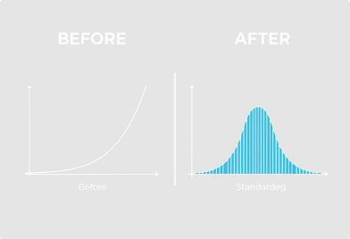
Standardization: The Gold Standard for Gaussian Data
When to Use
Advantages
Code Snippet
Features are ~Gaussian.
Maintains outlier structure.
Algorithms assume centered data.
Zero mean, unit variance.
from sklearn.preprocessing import StandardScaler
scaler = StandardScaler()
df[['Age', 'Fare']] = scaler.fit_transform(df[['Age', 'Fare']])

Slide 25





Normalization: Squeezing Features into a [0,1] Box
When to Use
Advantages
Example
Bounded features.
Preserves relationships for neural networks.
Normalizing "Fare" ($0–512 → 0–1) in the Titanic dataset.
Non-Gaussian distributions.
Intuitive [0,1] range.

Slide 26
Choosing Your Weapon: A Decision Guide
Criterion
Standardization
Normalization
Data Distribution
Gaussian-like
Any (bounded/unbounded)
Algorithm Fit
PCA, SVM, Linear Models
Neural Networks, K-Means
Outlier Handling
Robust
Distorts range

Slide 27

Hands-On: Scaling ‘Fare’ and ‘Age’
Choose Strategy
Standardization for Gaussian-like "Age," normalization for "Fare".
Apply Scaling
from sklearn.preprocessing import StandardScaler, MinMaxScaler
df['Age'] = StandardScaler().fit_transform(df[['Age']])
df['Fare'] = MinMaxScaler().fit_transform(df[['Fare']])
Validate
Plot distributions pre/post scaling.

Slide 28



Avoiding Scaling Disasters
Best Practices
Always fit scalers on training data only.
2
Use Pipeline to automate safe scaling.
Pitfalls
Code Demo (Pipeline)
Scaling test data using training statistics (leakage).
1
from sklearn.pipeline import Pipeline
from sklearn.linear_model import LogisticRegression
pipeline = Pipeline([('scaler', StandardScaler()), ('model', LogisticRegression())])
Applying normalization to sparse/outlier-heavy data.
3

Slide 29


What Would You Do?
Feature A
1
Gaussian (mean=50, std=10) - Use Standardization
Feature B
2
Bounded (0–1000), right-skewed - Use Normalization

Slide 30
Key Takeaways
1
Fair Feature Comparison
Scaling ensures fair feature comparison in distance/weight-based models.
2
Scaling Choice
Standardization for Gaussian-like data; normalization for bounded ranges.
3
Prevent Data Leakage
Always use pipelines to prevent data leakage.

Slide 31
Encoding Categorical Variables

Slide 32
Categorical Data Encoding: Speaking the Language of Machines
Translating human-readable categories into machine-digestible numbers, while avoiding bias. We'll learn to encode fairly.

Slide 33
What You’ll Learn
Why Encode?
How to Choose?
Avoid Pitfalls
Categorical data must be converted for ML models.
Choose between label encoding and one-hot encoding.
Avoid ordinal bias and dimensionality explosion.

Slide 34
The Risk of Arbitrary Encoding
Algorithmic Misinterpretation
1
Label encoding implies order.
Real-World Impact
2
Biased loan approvals possible.
Key Insight
3
Treats numbers as continuous.

Slide 35

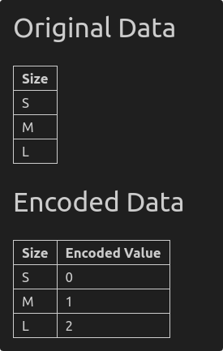
Label Encoding: Simple but Risky
When to Use
Ordinal data with inherent order.
Tree-Based Models
Ignore false order.
Example
from sklearn.preprocessing import LabelEncoder
encoder = LabelEncoder()
df['Size'] = encoder.fit_transform(df['Size'])
Risk
Misleading assumptions.

Slide 36

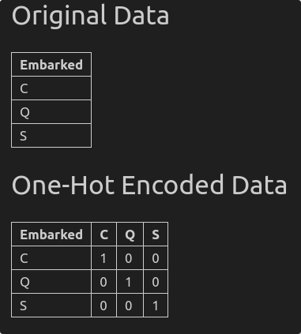



One-Hot Encoding: The Gold Standard
Method
Binary column per category.
When to Use
Nominal data (no order).
Code Snippet
from sklearn.preprocessing import OneHotEncoder
encoder = OneHotEncoder(drop='first')
encoded = encoder.fit_transform(df[['Embarked']])

Slide 37

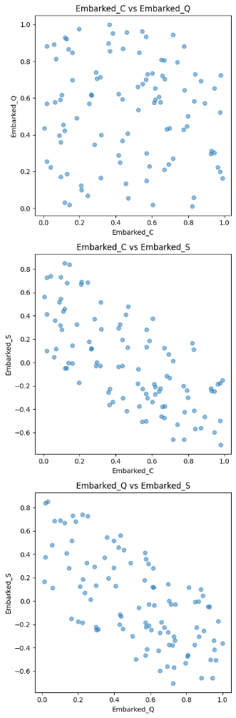
The Dummy Variable Trap
Problem
Solution
Multicollinearity is created.
Drop one column.
Y=β0​ + β1​X1​ + β2​X2​ +… + βn​Xn​ + ϵ
Example
3 columns to 2.

Slide 38



High Cardinality: When One-Hot Fails
Target Encoding
Target variable statistics
Frequency Encoding
Embedding
Occurrence counts
Advanced techniques
2
1
3

Slide 39
Case Study: Encoding the Titanic Dataset
1
Label or One-Hot Encode "Sex"
Based on model type.
2
One-Hot Encode "Embarked"
Drop='first' to avoid trap.
3
Validate
Check for multicollinearity.
4
Code Example
from sklearn.compose import ColumnTransformer
preprocessor = ColumnTransformer(transformers=[
('onehot', OneHotEncoder(drop='first'), ['Embarked', 'Sex'])
])
df_encoded = preprocessor.fit_transform(df)

Slide 40

Encoding Do’s and Don’ts
Do
Don't
One-hot for nominal
Label encode nominal
Drop a category
Ignore sparse matrices
Handle cardinality

Slide 41



Key Takeaways
Label Encode
1
Only for ordinal
One-Hot Encode
2
Nominal data
Simplify
3
High-cardinality

Slide 42
Encoding Categorical Variables

Slide 43

Automating Preprocessing: Building Robust Pipelines
From manual workflows to one-click reproducibility.
Key Quote: "A pipeline is your blueprint for clean, leak-proof data transformations."

Slide 44
What You’ll Learn
Objectives
Why Pipelines?
Design pipelines with ColumnTransformer
Ensure consistency across training/testing
Prevent data leakage
Replace manual steps with a single call
Integrate preprocessing with models

Slide 45

Benefits
Reproducibility across teams/environments
Seamless hyperparameter tuning
Leak-proof transformations
Example: Accidentally scaling test data using training stats.
Pipelines: Every dish (model) tastes the same.

Slide 46


Custom Workflows for Heterogeneous Data
Numerical
Categorical
from sklearn.compose import ColumnTransformer from sklearn.pipeline import Pipeline num_transformer = Pipeline(steps=[ ('imputer', SimpleImputer(strategy='median')), ('scaler', StandardScaler()) ]) cat_transformer = Pipeline(steps=[ ('encoder', OneHotEncoder(drop='first')) ]) preprocessor = ColumnTransformer(transformers=[ ('num', num_transformer, ['Age', 'Fare']), ('cat', cat_transformer, ['Sex', 'Embarked']) ])

Slide 47





Putting It All Together: Titanic Dataset
Raw Data
Impute Age
Encode Sex
Scale Fare
Train Model
Pipeline handles everything - no more forgotten steps or leakage.

Slide 48

The Leak-Proof Pipeline
What is Leakage?
Contaminating test data with training stats (e.g., mean, variance).
Pipeline Safeguards
fit_transform() on training data only
transform() on test data

Slide 49

Your Mission
1
Handle missing values
2
Encode categorical features
3
Scale numerical features
4
Build a pipeline
Dataset: Housing Prices (e.g., missing "LotFrontage," categorical "Neighborhood").

Slide 50
Code Walkthrough: Housing Prices Pipeline
Load Data
1
import pandas as pd df = pd.read_csv('housing.csv')
2
Inspect Missing Values
df.isnull().sum()
Preprocessing Plan
3
Impute "LotFrontage" with median.
One-hot encode "Neighborhood."
Scale "SalePrice" and "SquareFeet."
Pro Tip: Use Pipeline.fit_transform() on training data only. Test data should use .transform()!

Slide 51



Don’t Get Stuck!
2
Dummy Variable Trap
Forgetting to drop one one-hot column
Data Leakage
Scaling test data with training parameters
1
Incorrect Column Types
3
Passing strings to a scaler

